Slide 1
Mashable Article Popularity

Slide 2
What is Popularity?
In this project, popularity was defined by the number of shares that an article received.
As opposed to views, which represent the number of times an article was simply seen by a reader, shares imply that a reader viewed, read, and enjoyed an article so much they took the time to share it on social media for others to read.
Popularity
Shares
Views

Slide 3
What Makes Popularity?
In Short...
Positive sentiment
Long articles with simple words
References
Keywords, keywords, keywords!

Slide 4
Analysis
The Search for Popularity

Slide 5
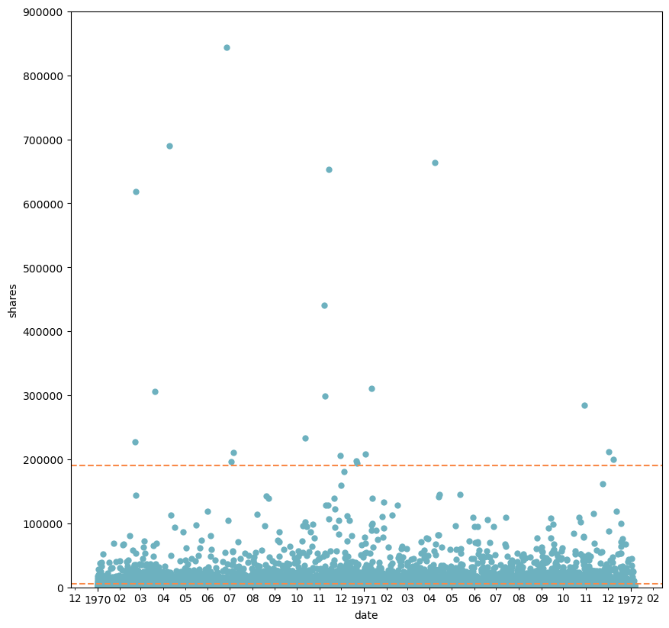
Viral Articles
Viral articles are a subset of popular articles that preformed significantly better than other articles.
While most popular articles were under the 100,000 shares range, these viral articles hit as high as 800,000 shares.
Threshold for Viral Articles
Threshold for Popular Articles

Slide 6
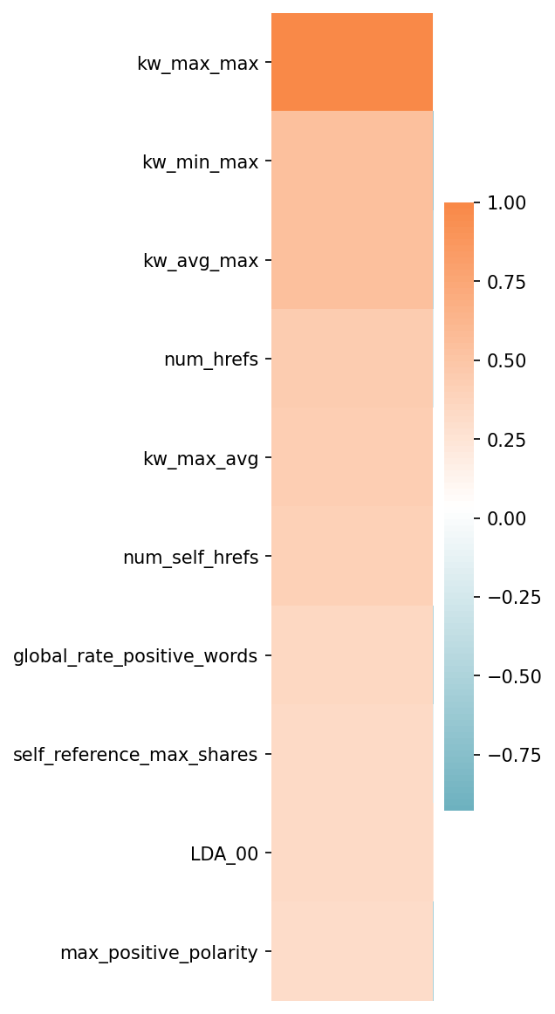
What Do Viral Articles Have in Common?
Separating the viral articles, I used a correlation matrix to determine what features correlated with shares.
Positive Correlation:
High shares in all keywords
References
Positive Sentiment

Slide 7
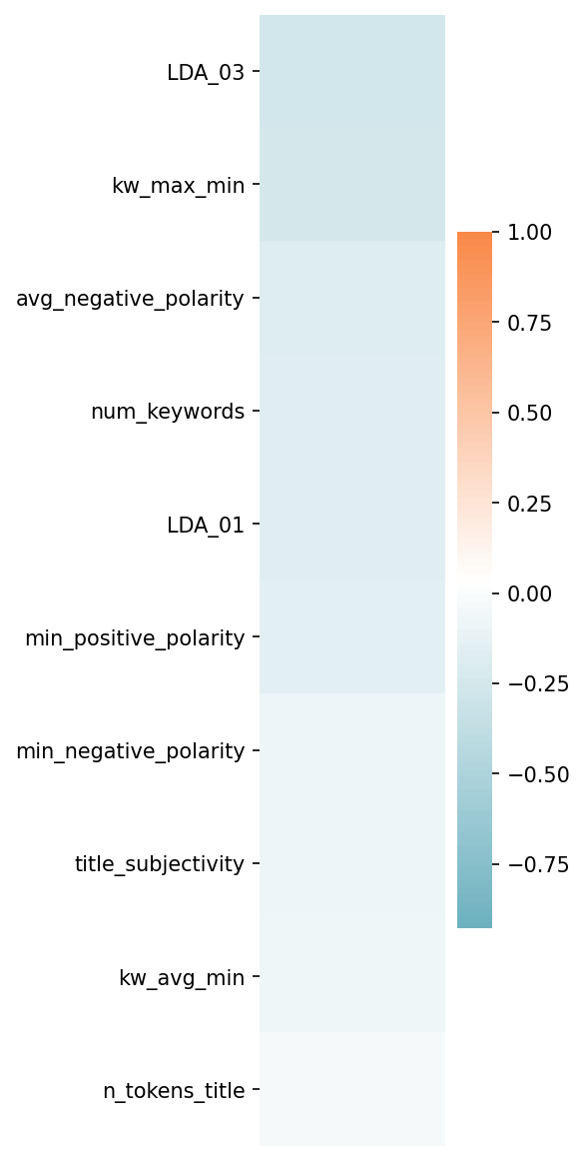
What Do Viral Articles Have in Common?
Separating the viral articles, I used a correlation matrix to determine what features correlated with shares.
Negative Correlation:
Low shares in all keywords
Negative Sentiment
Title Subjectivity

Slide 8
Clustering
word
Cluster 1
Positive
Less text, longer words
word
Cluster 2
Positive and slightly subjective
More text, shorter words
More references
word
Cluster 3
Negative
Less text, longer words
word
Cluster 4
Articles with little to no text word
Using K-Means Clustering, the data was bunched into four separate groups.

Slide 9
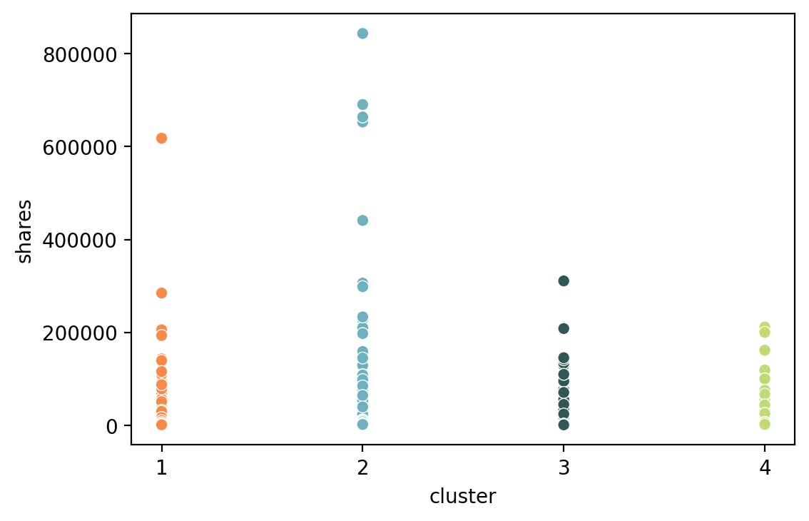
Clustering
Cluster 2 had the most popular and viral articles followed by Cluster 1.
This could imply that the features present in Cluster 2, not only aid in popularity, but also to an article’s likelihood of becoming viral.
Cluster 2
Positive
Subjective
More text
Short words

Slide 10
Modeling

Slide 11
The Big Question
The Short Answer
Can A Model Predict Popularity?
Not Really…

Slide 12
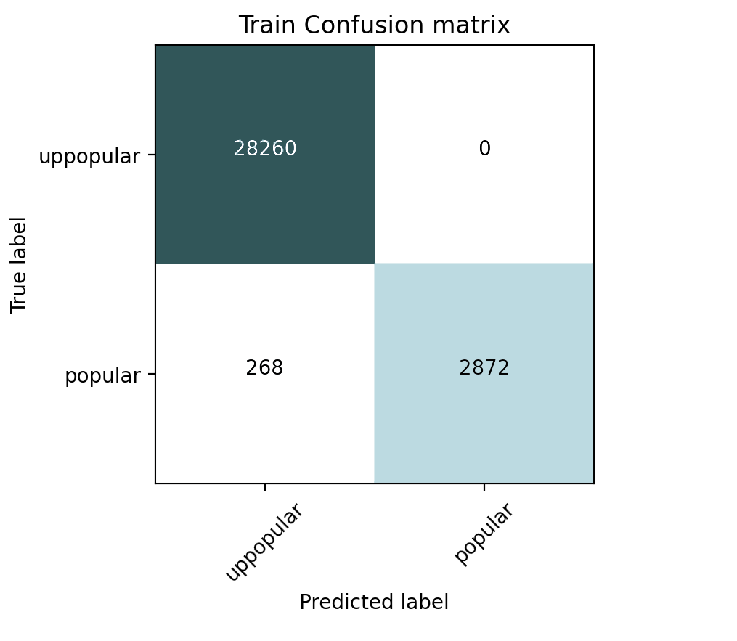
The Long Answer
Random Forest model for Binary Classification
Model could only identify a particular subset of popular articles.
Even when testing the model with the training data, the model correctly labels only 91% of the popular articles

Slide 13
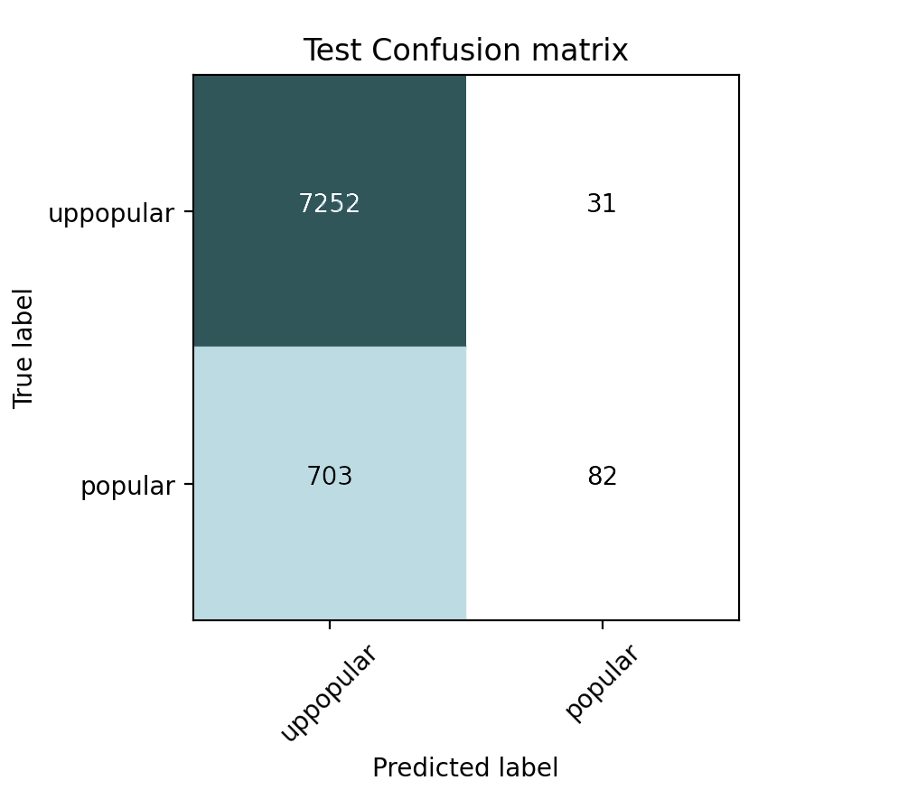
The Long Answer
When tested on new data, the model could only identify 11% of the popular articles.
Out of the articles it did label as popular, 73% were accurately labeled.
Overall, the model fails to identify all popular articles but does has a 73% accuracy for those it did label as popular

Slide 14
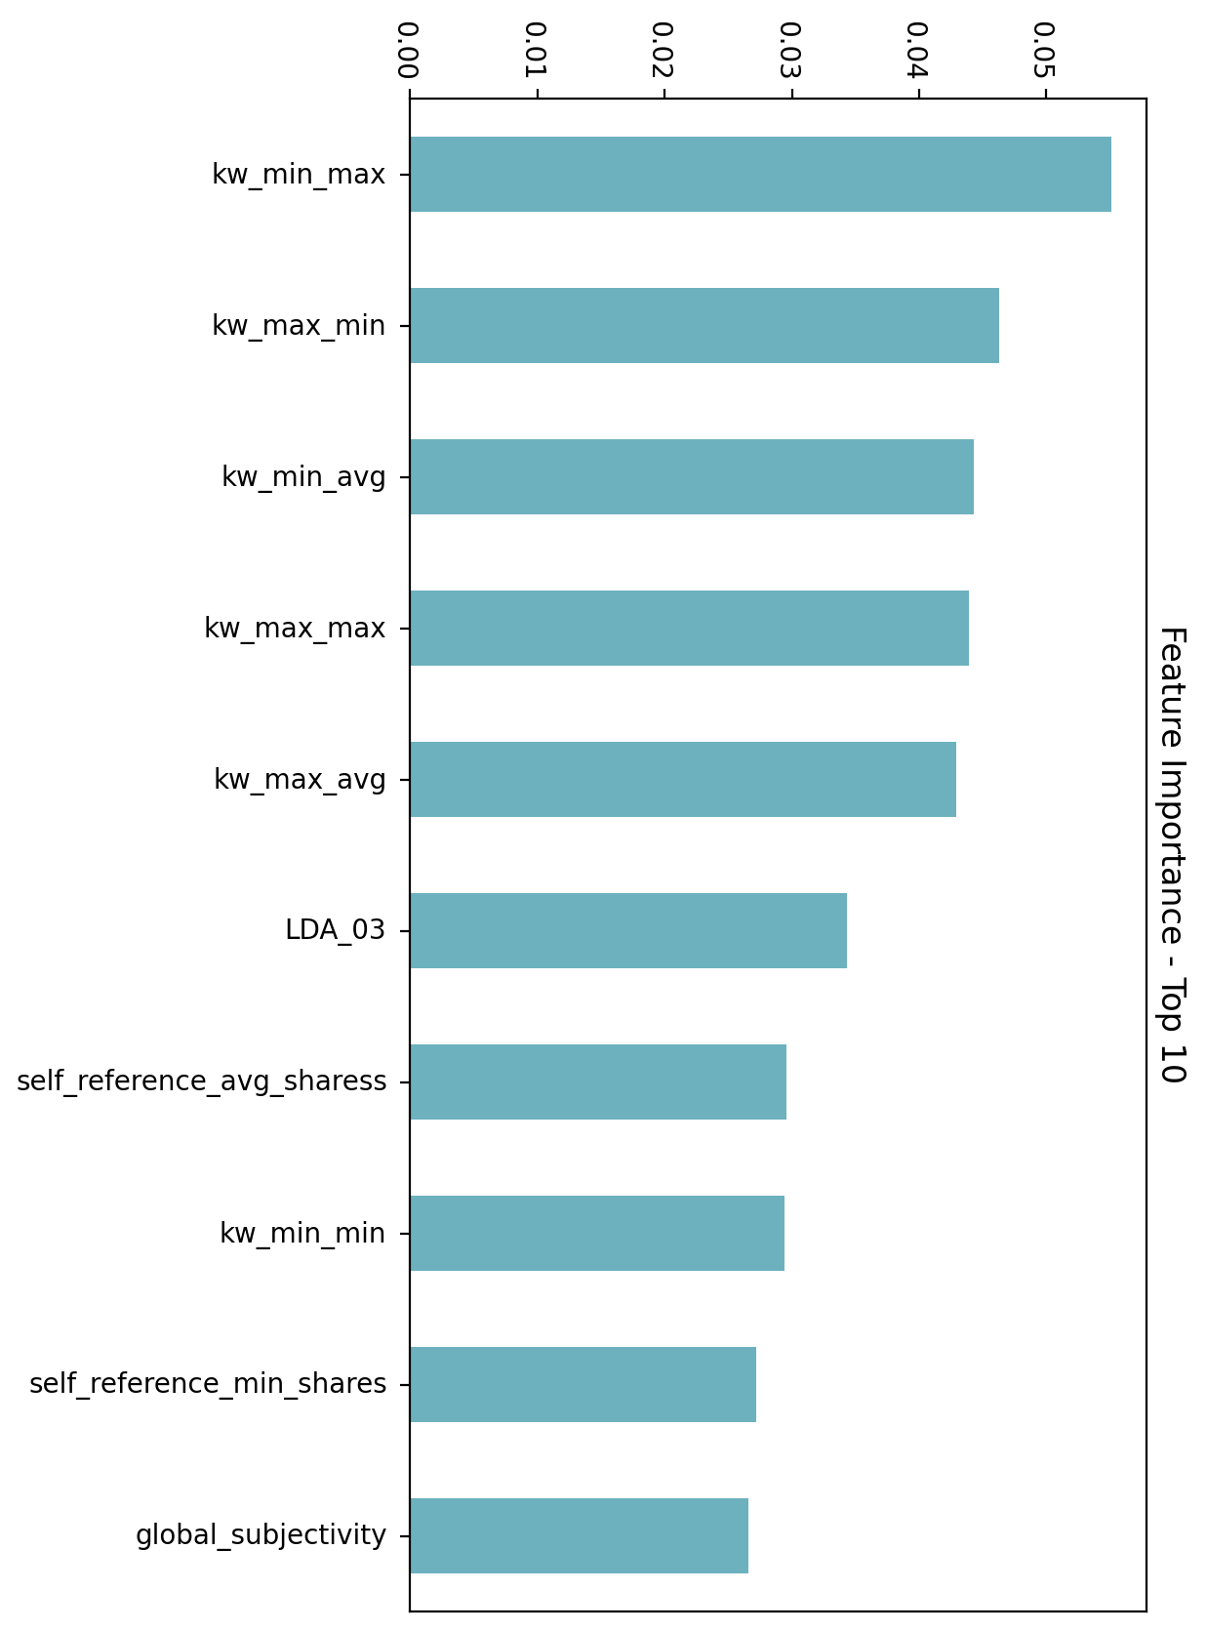
Feature Importance
So what features are the most important factors in determining popularity according to the model?
Shares of articles in the same keywords
Shares of articles referenced
Subjectivity

Slide 15
Conclusions
Putting it all together

Slide 16





So What Makes An Article Popular?
Text Features
Article Interconnectivity

Slide 17
Text Features
All readers want different things, but there are definitely some common traits among popular articles. Altogether the most popular articles tended to be:
P People like a ‘feel good’ story
P Don’t be afraid of a lot of text
P Keep words short and uncomplicated
P Don’t be afraid of being a little subjective
Positive
Long
Simple
Subjective*
* Do try to avoid subjective titles though!

Slide 18
Article Interconnectivity
Popular articles tend to attract attention to the articles related to it through keywords and references. Mashable could use this to their advantage by taking actions such as..
Improve Suggested Articles
Continue to improve how articles are recommended to readers by utilizing user viewing habits or suggesting articles similar to what is currently being viewed.
Identify popular or viral articles early and provide these articles with more article recommendations.

Slide 19
Article Interconnectivity
Popular articles tend to attract attention to the articles related to it through keywords and references. Mashable could use this to their advantage by taking actions such as..
Clean up the Keywords
There were 16,724 different keywords, only 8,035 (~48%) of which were used more than once.
Creating a distinct set of keywords for authors to choose from would help build the connections between articles.
Would also help the recommendation engine find similarities and create better suggestions

